Slide 1
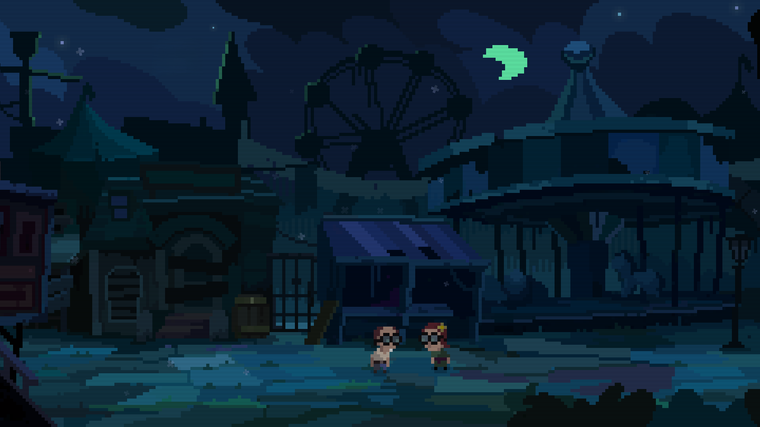




When hell runs a dark ride, no one is safe.

Slide 2
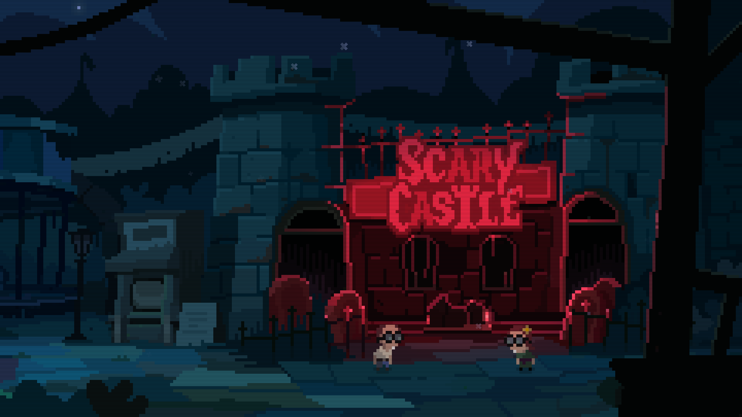
A 2D pixel-art roguelite action-adventure where bizarre comedy collides with creepy monsters and absurd challenges.

Slide 3
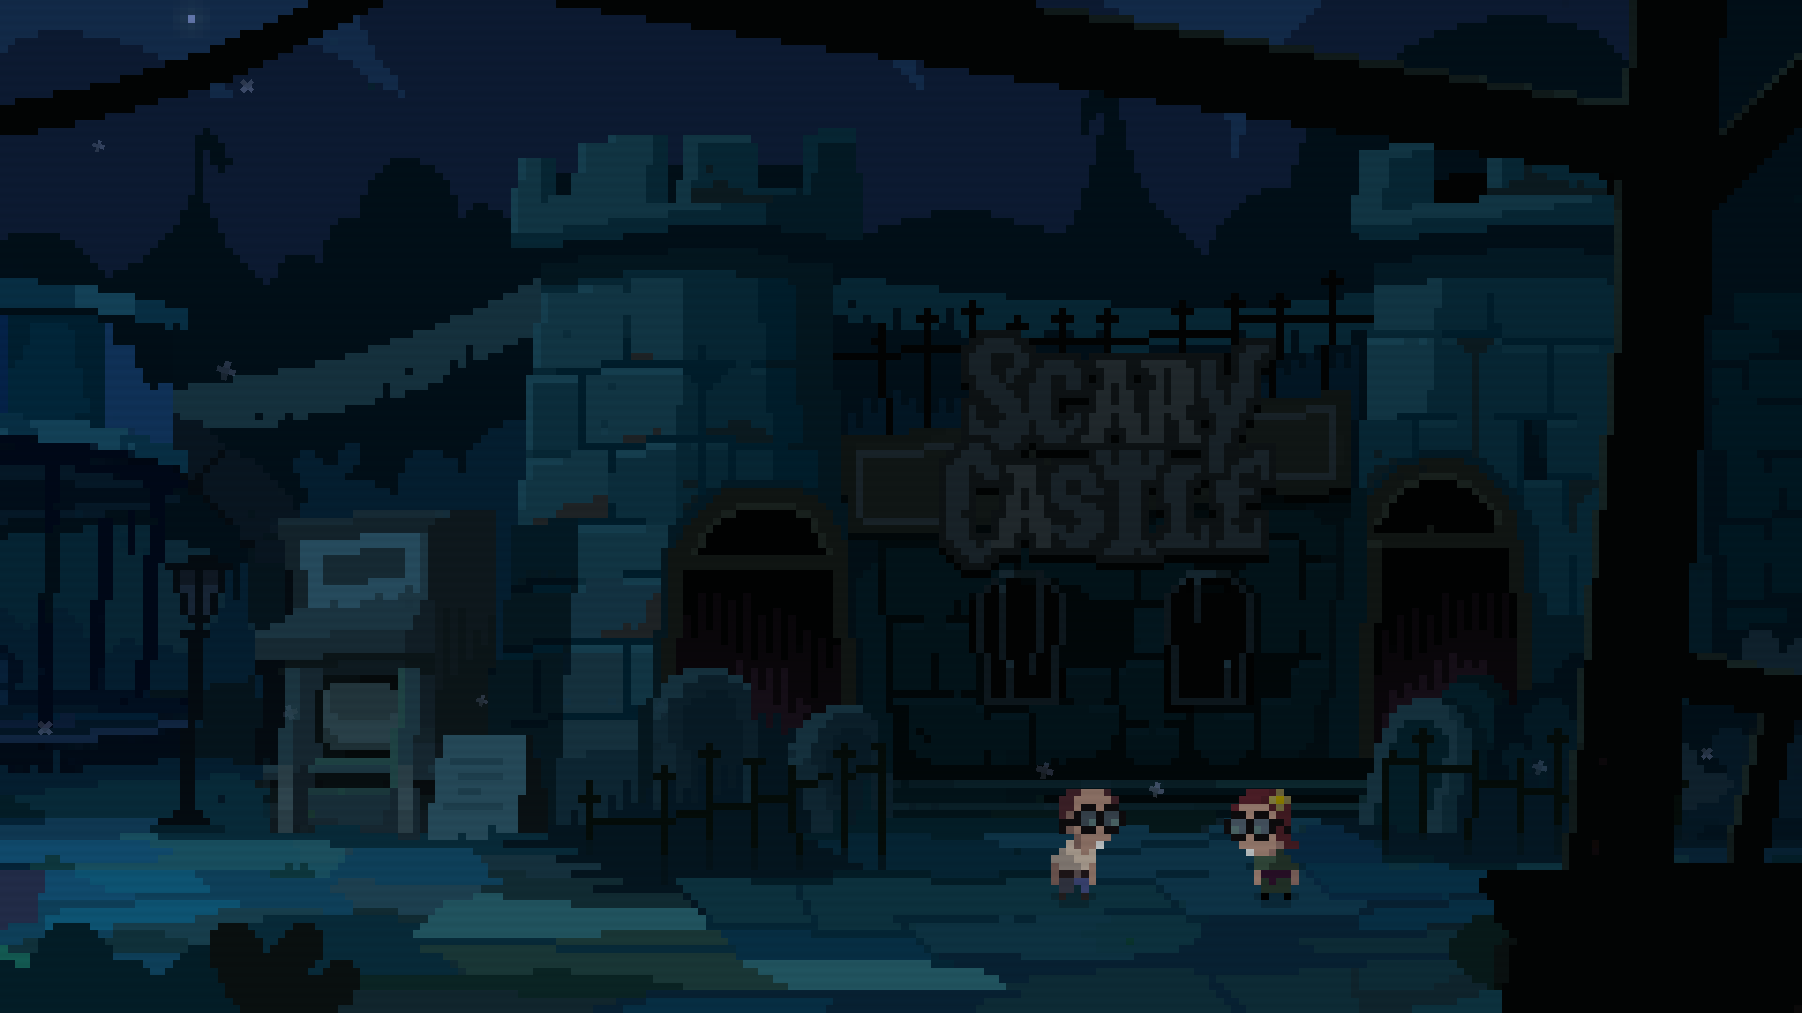
WHY IT’S UNIQUE
Procedural Absurdity
A high-density procedural engine ensures every run delivers a unique nightmare filled with evil creatures, hidden secrets, and unpredictable challenges.
The “Economy of Sin”
A satirical narrative hook—with the Devil's heir retired, evil has vanished from Earth. Now, a bankrupt Heaven is forced to intervene to save the "Business of Faith."
A "Telenovela" Core:
Narrative isn't just flavor. Each playthrough fuels a bizarre, evolving drama where twisted relationships and absurd plot twists unfold dynamically.

Slide 4
INSPIRATIONS & POSITIONING
The Binding of Isaac
Procedural structure, replayability, and run-driven progression.
South Park / Day of the Tentacle
Absurd, irreverent humor with eccentric characters and surreal situations.
Cult of the Lamb
Dark-comedy aesthetic and a playful contrast between cute art and sinister themes.

Slide 5
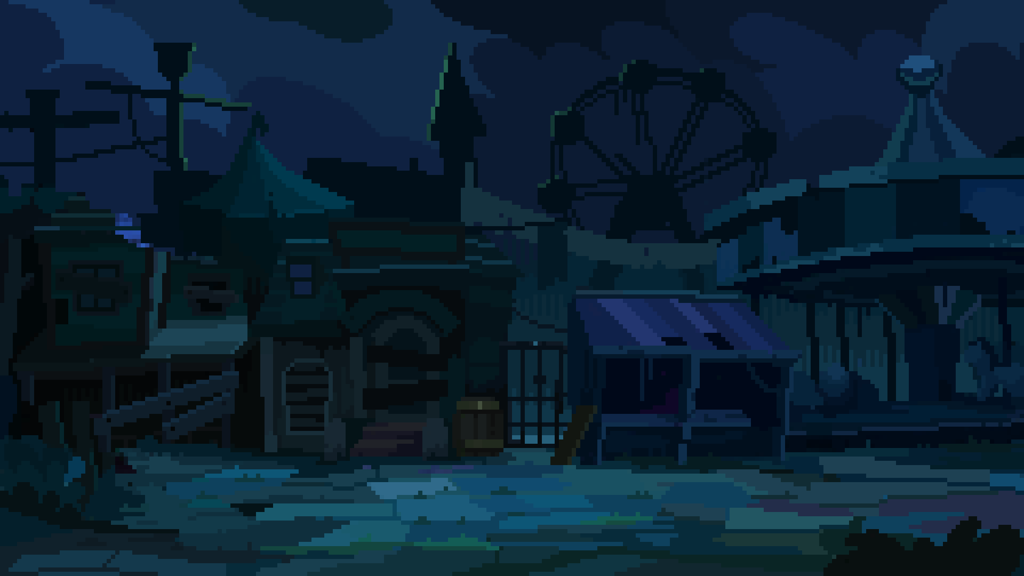


SPECIFICATIONS
Genre: Roguelite/action-adventure
Graphics: 2D Pixel art/retro style
Rating: Mature humor, mild blood
Playtime: 20-26 hours
Technology: MonoGame/Proprietary engine
Platform: Steam (PC)
Business model: Premium + (DLCs/expansions)
Price point: USD 14.99

Slide 6
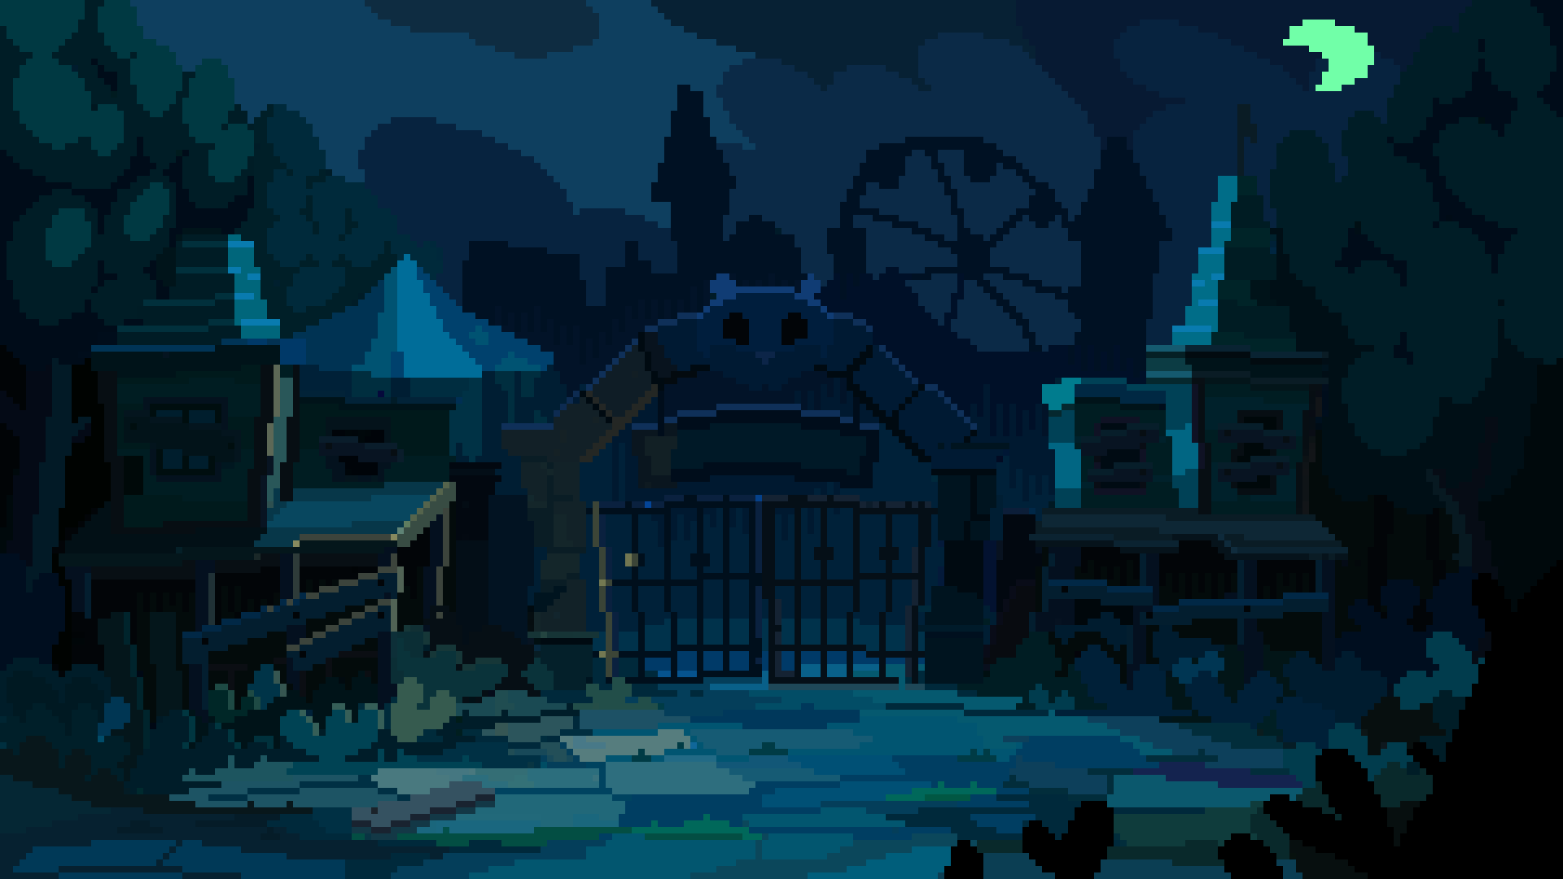


STORY & SETTING
The attraction Snuggleville’s amusement park was once home to Scary Castle, a grotesque dark ride.
The incident
During the grand opening, the ride’s designer and a group of celebrity guests stepped into the ghost train… and never came out. The park was shut down that very same day, leaving the attraction to rot as a haunted mystery.
The unexpected heroes
Two lazy journalists sneak inside to investigate chasing the story that could finally make their magazine famous.
The curse
The attraction is now ruled by Mandinga — the Devil’s only son and heir.

Slide 7



MAIN CAST
Edmund Idle
The anti-hero.
Mandinga
The Devil’s only son and heir. His father died in a gas-leak accident while roasting a sinner. He isn't interested in your soul; he just wants to make sure the animatronics are working perfectly.
Sister Ham
Mandinga’s assistant. Keeps the attraction in order mostly by screaming and oinking.
Lord Percival
A famed designer of horror attractions. On opening day, he and several celebrities entered the ride… and never came out.

Slide 8
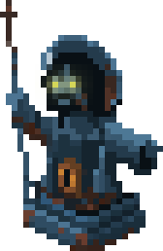





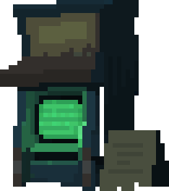


GAME STRUCTURE
Theme park
The Ride (procedural)
Find the coin.
Ride Entrance
Ride
Run completed
ATM connected to Percival’s computer
Intense action, tunnels, dungeons, strange rooms and captive celebrities.
Find RAM to expand Percival’s computer memory.
+RAM unlocks deeper tiers, revealing new areas and benefits within the ghost train.
Collect tickets and buy items.
RAM = Metaprogression Tree.
Lose all run progress on death.

Slide 9
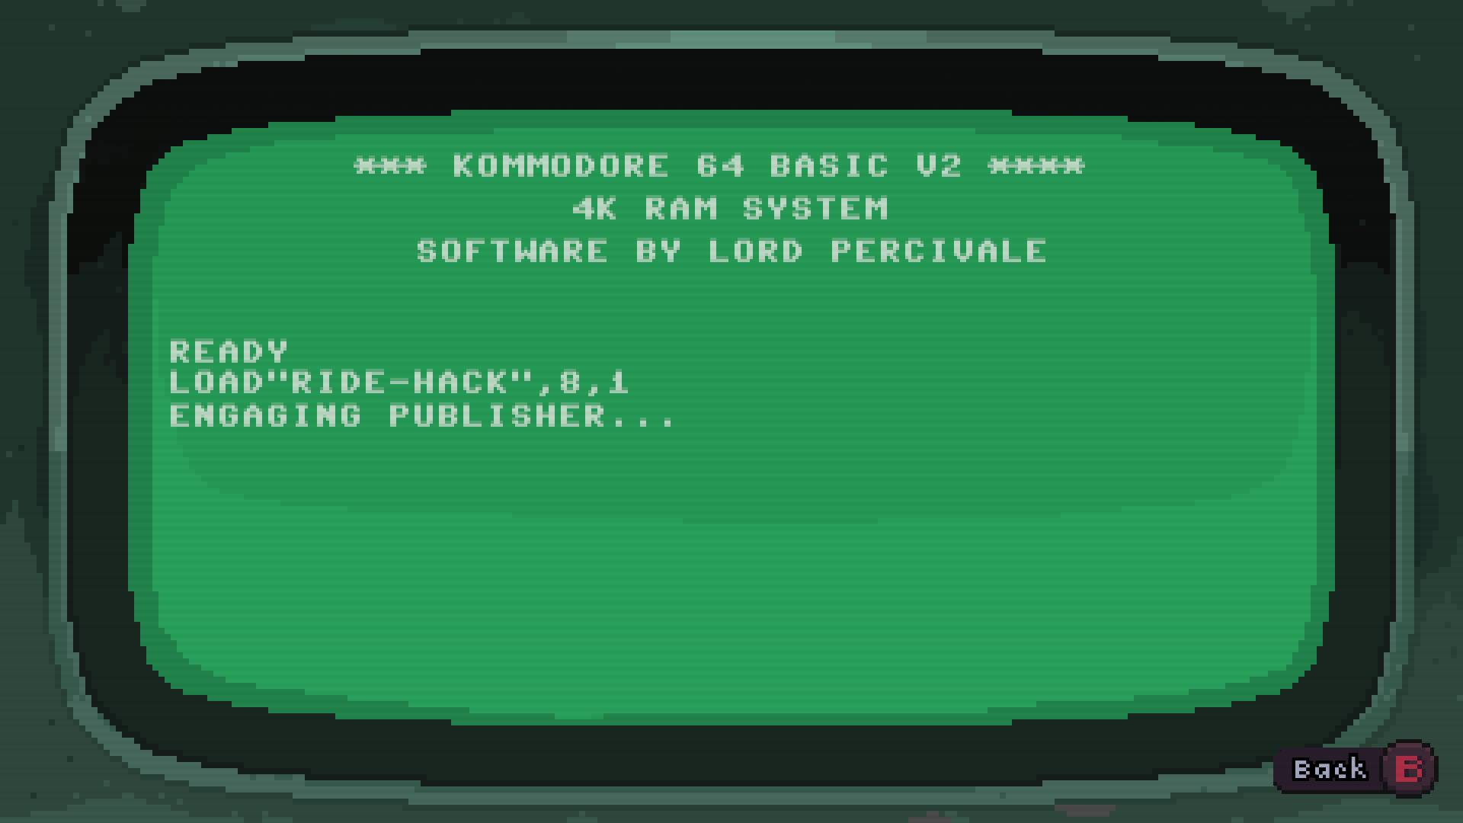

Slide 10






DYNAMIC INVENTORY
Collect and adapt with whatever bizarre items you find along the way.
Left hand
Odd junk you can equip to whack, shoot, or do something questionably effective.
Gadgets
Passive oddities with quirky powers, masks, hats. One at a time, so choose wisely.
Right hand
Useful contraptions for odd jobs — dig, plant, prank, or blow stuff up.
Key items
Scene-specific tools for interacting with the environment.
Consumables
Single-use consumables with a wide array of immediate effects to aid your progress through the ride.

Slide 11

CURRENT STATUS
Technology
Proprietary MonoGame/C# engine with scripting language and 2D lighting system.
Art & Tone established
Pixel art style and absurd humor already defined in the prototype.
Procedural Engine
A stable procedural engine built to scale seamlessly from its current core into a high-density asset library.
Ready to expand
With the base systems stable, next step is expanding into full adventure content.

Slide 12
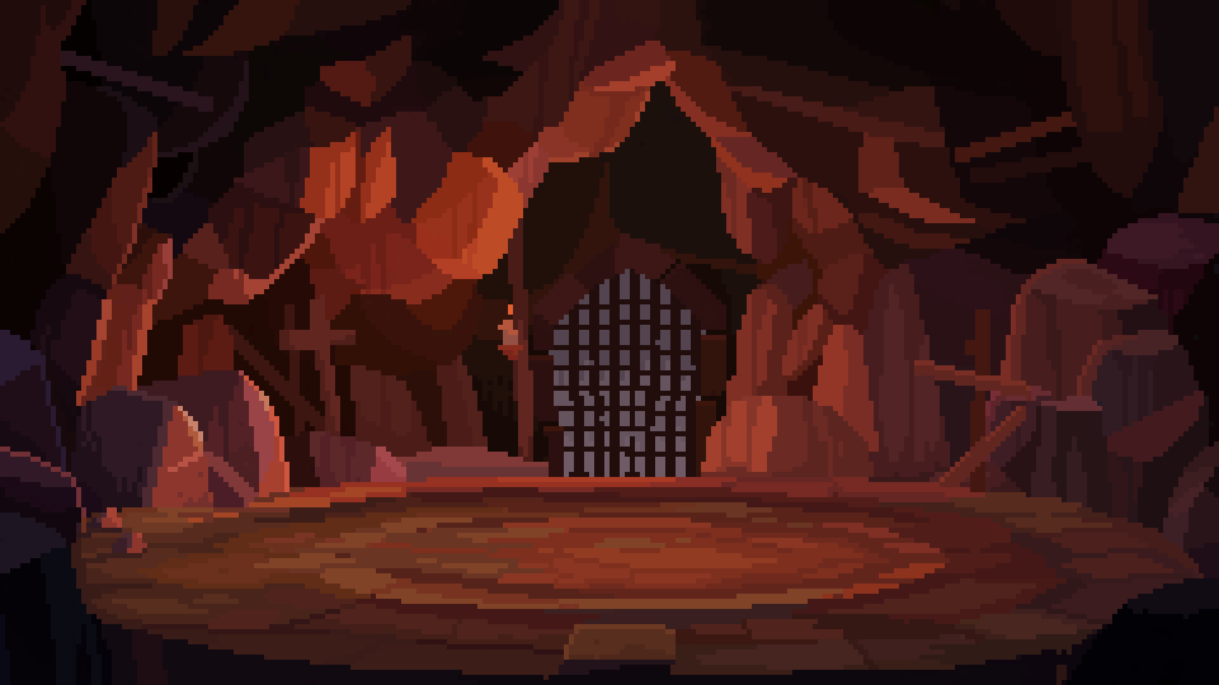


NEEDS
Funding
To produce the full adventure:
30+ creatures
100+ items
10+ secondary cast
12 captive celebrities
8 bosses
New tunnels & rooms
Story arc
Original soundtrack
Localization (*)
Professional localization to reach a wider audience.
Console porting (*)
The game is easily portable. Our code is AOT-friendly. All porting would be done by the publisher or external teams.
Marketing Assets (*)
Trailers, key art, and additional promotional materials.
(*) Handled by the publisher. Not included in the development budget.

Slide 13
PRODUCTION
Development time: 14 months
Budget: 170k USD (*)
Budget distribution:
Design & Writing: 20%
Art & Animation: 30%
Programming & Tools: 30%
Audio & Music: 15%
QA/Misc: 5%
(*) Does not include trailer production, localization and console porting.

Slide 14

EXPANSION POTENTIAL
The procedural architecture allows the game to expand indefinitely with new post-launch content.
The modular design enables cost-efficient updates and multiple sales cycles over time.
Aca ponerlo inspiracional recorder charla con mateo todo el horizonte de expansion que tiene el juego. Que lo proyecte el que lee el deck.

Slide 15
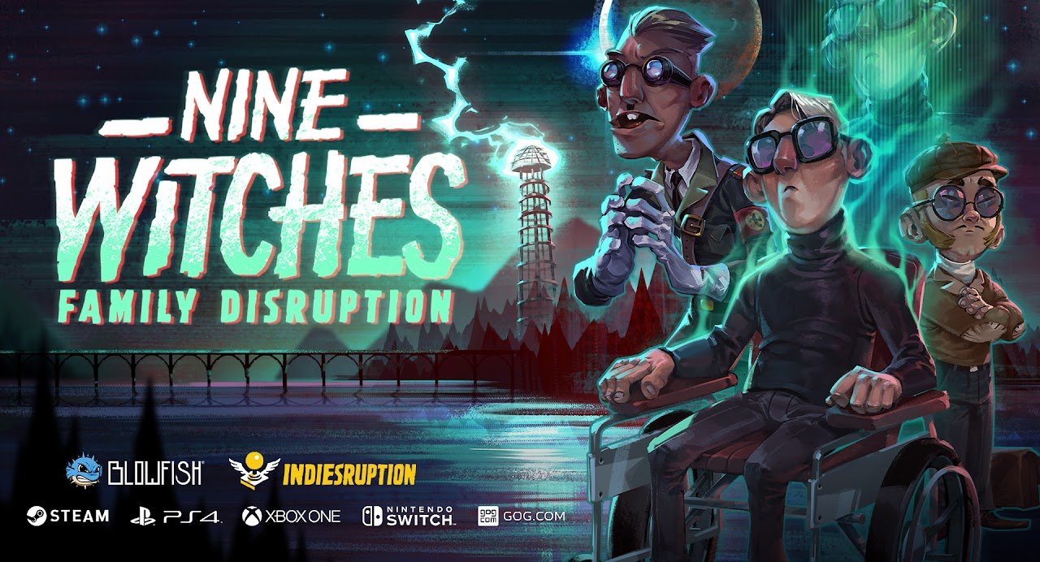
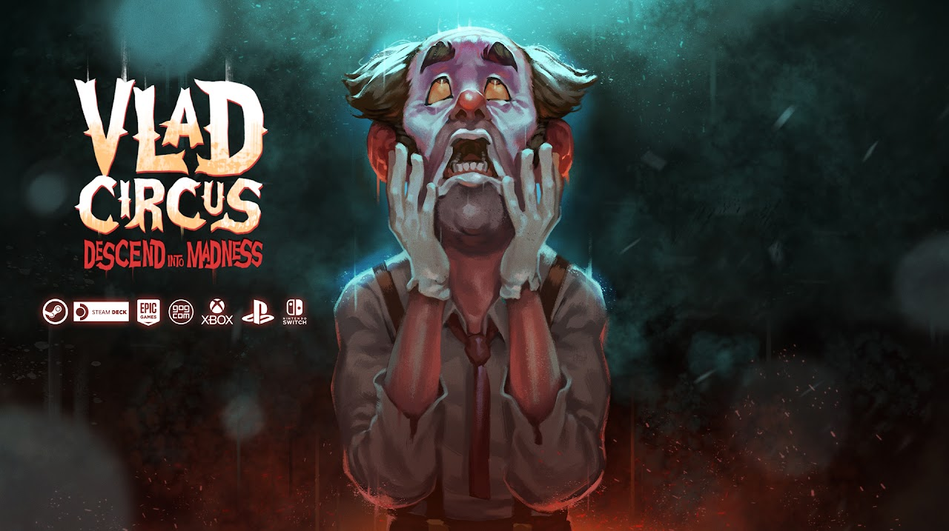
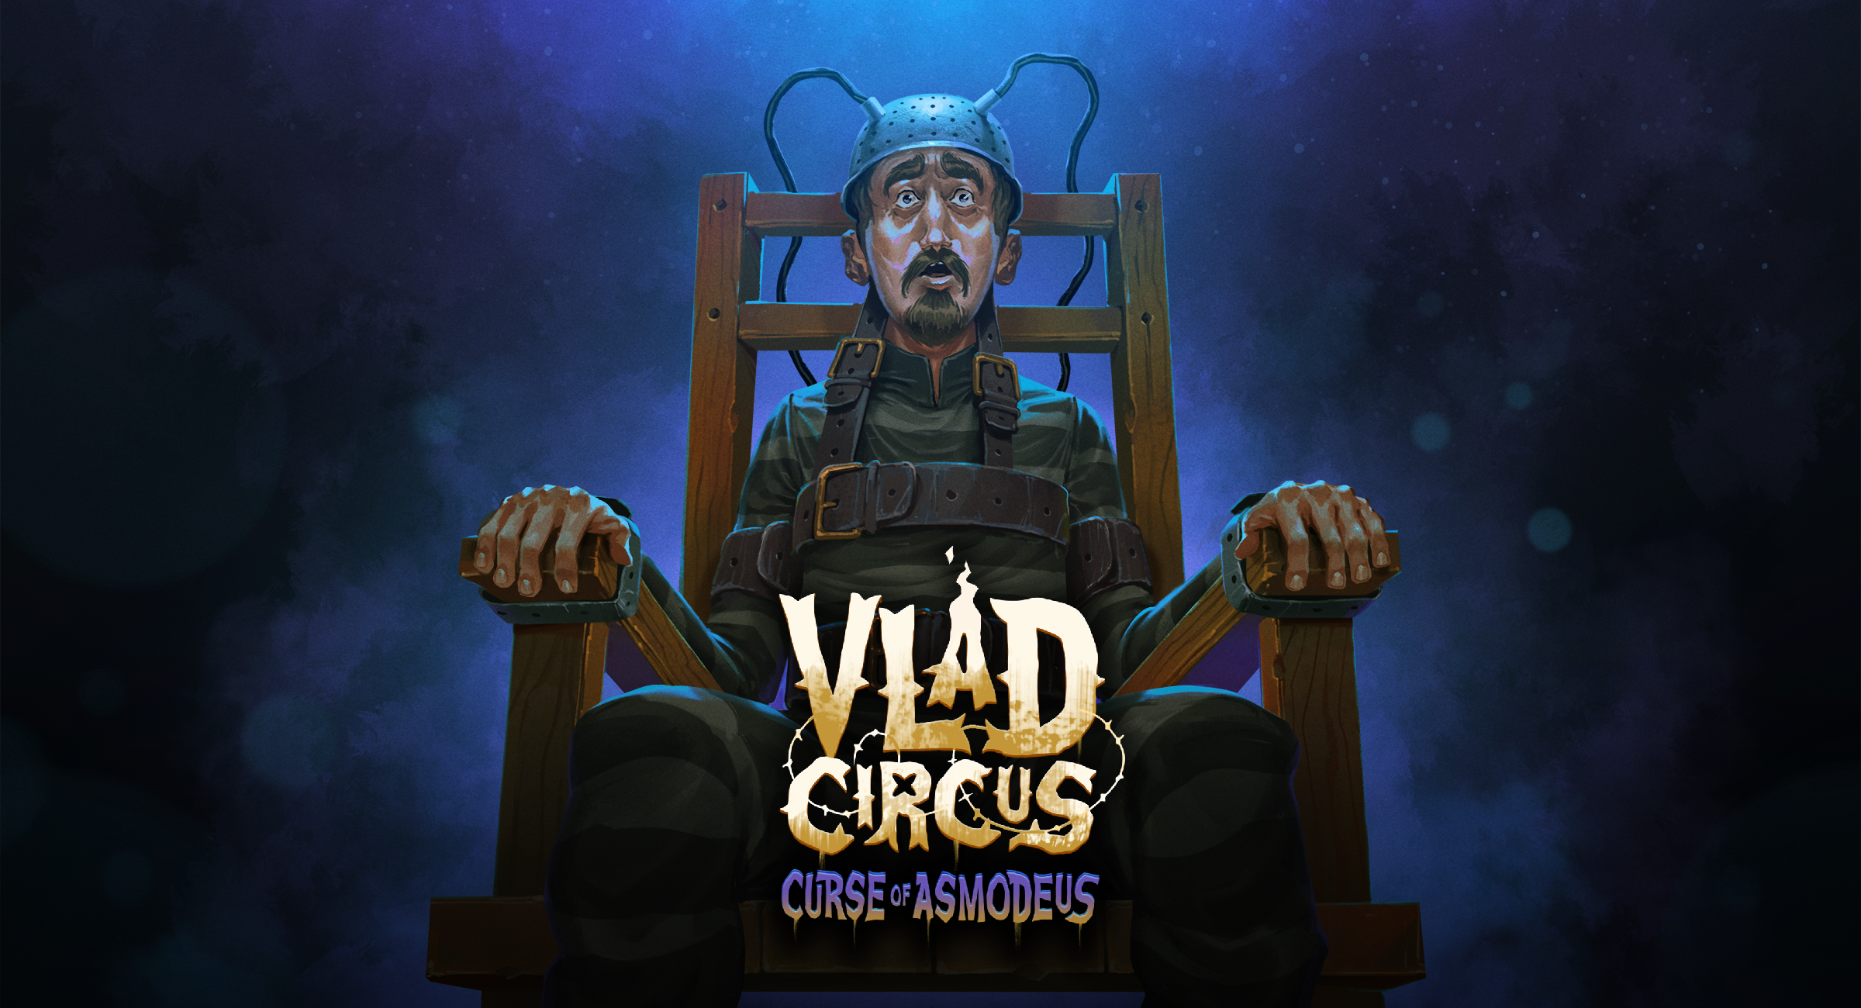
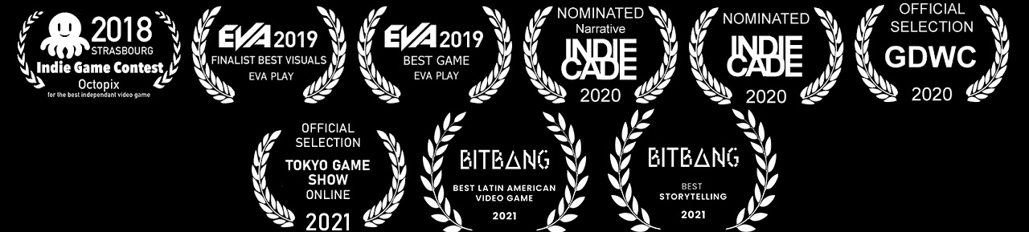

OUR GAMES
2020
2023
2025
Shipped on PC and major consoles, award-winning for creativity and originality.

Slide 16


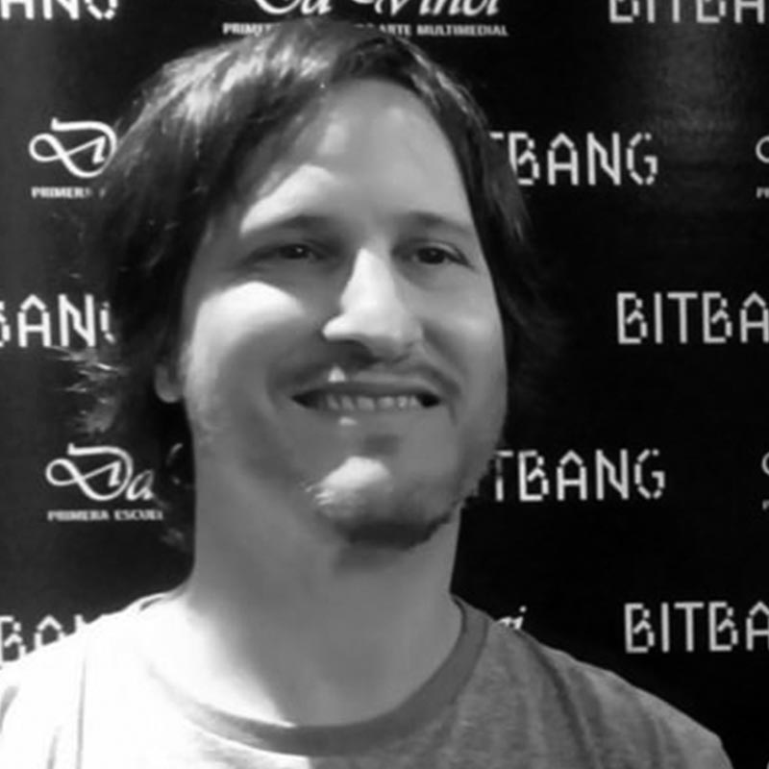
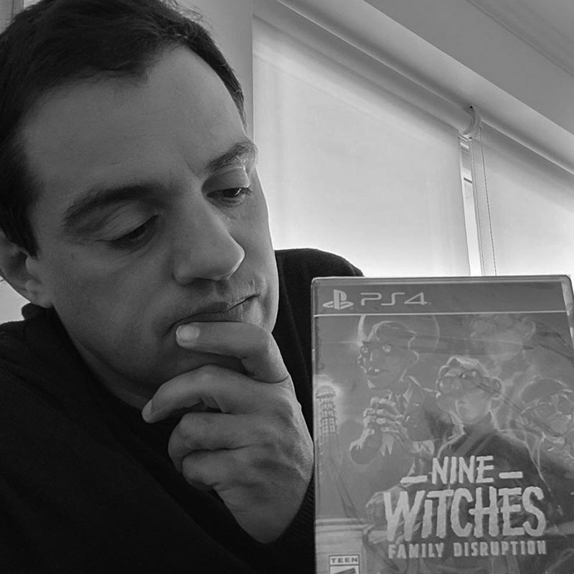


Veteran indie developers 30+ years of combined experience.
Celebrity found!
Bill Doors
See you in hell!
Diego Cánepa
Founder
Lead Designer Programmer
Pablo Mamone Lead Designer
Project Manager
Durgan Nallar
Game Designer Narrative Designer
Contact: diego@indiesruption.com

